Slide 1
TAXI Out time Analysis at SAN DIEGO International Airport
Chandhnee Karthikeyan Iyer

Slide 2
AGENDA
Understanding the Data
Exploratory Data Analysis
Forecasting
Takeaways

Slide 3
APproach
Understanding data:
Python (Google Colab), MS Excel
Exploratory Data Analysis:
Tableau
Forecasting:
Python (Google Colab)

Slide 4
Understanding the data

Slide 5
DATA
A record of all Flights departing from San Diego International Airport in 2017 and 2018
GRAIN
A Record represents a departure from San Diego International Airport
VOLUME
188525 records
VARIETY
Across 14 different Airlines

Slide 6
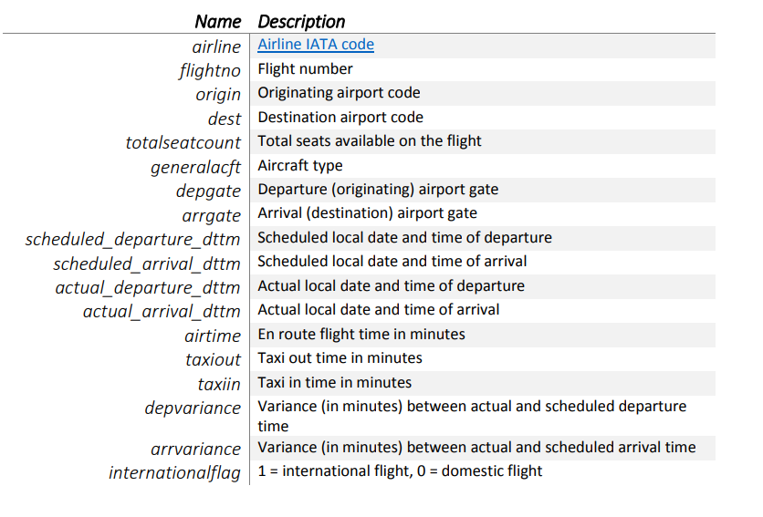
THE DataSET

Slide 7
ANOMALIES

Slide 8
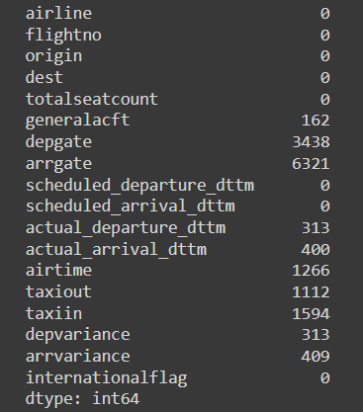
NULL VALUES in DATA
ANALYSING NULLS IN VARIABLES of INTEREST
TAXIOUT: 0.005% of records
Departure Gates: 0.018% of records
Actual Departure Time and Actual Arrival Times for < 0.001% of records

Slide 9
POTENTIAL INCORRECT VALUES in DATA
OUTLIERS
Values greater than 1.5* IQR
TAXI IN
TAXI OUT
NON-CONFIRMING DATA
AIRTIME has negative values
Actual Arrival Time has values in 1970
Departure Gate has gates that do not belong to San Diego Airport

Slide 10
ASSUMPTIONS

Slide 11
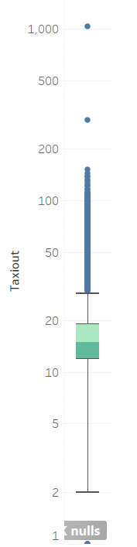
TAXIOUT
Most values are distributed between 12 and 19 minutes
There are several valid outliers. One invalid outlier above 1000 has been ignored
1112 null values which I attribute to:
Flight Cancellation (missing actual arrival and departure time )
Data recording issue
Airline G4 does not record Taxiout time (58% of null taxi out come from gate 30 and G4 Airline)

Slide 12
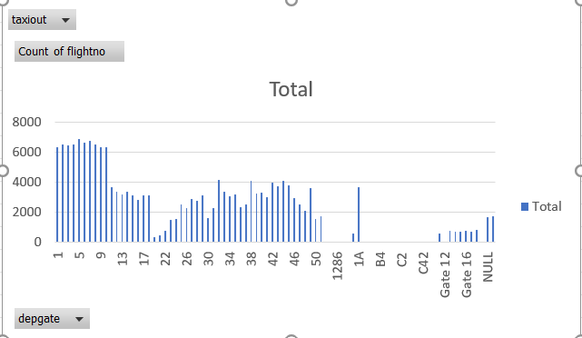
Departure gate
Remove Suffix ‘GATE’
As per publicly available information SAN DIEGO airport only has gates 1-51 and gate 1A. Therefore all other gates listed in the graph are marked incorrect and ignored.
Terminal 1: Gates 1-18 and 1A
Terminal 2 : Gates 19-51

Slide 13
Exploratory data analysis

Slide 14
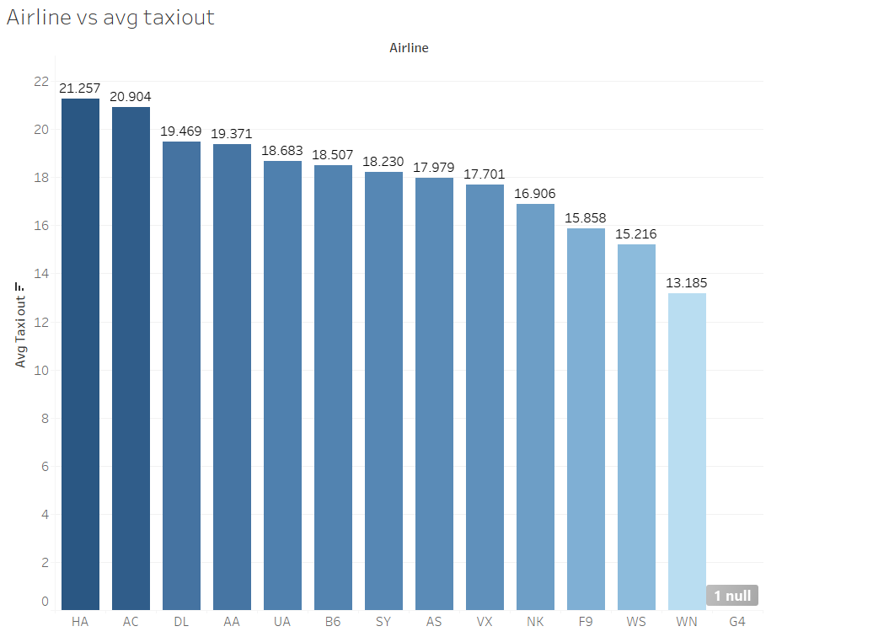
How Does taxi out time vary by airline
Southwest Airline (WN) has the lowest Taxiout time
Hawaiian Airlines has the highest
Alaska Airlines (AS) has a comparatively low Taxi out time

Slide 15
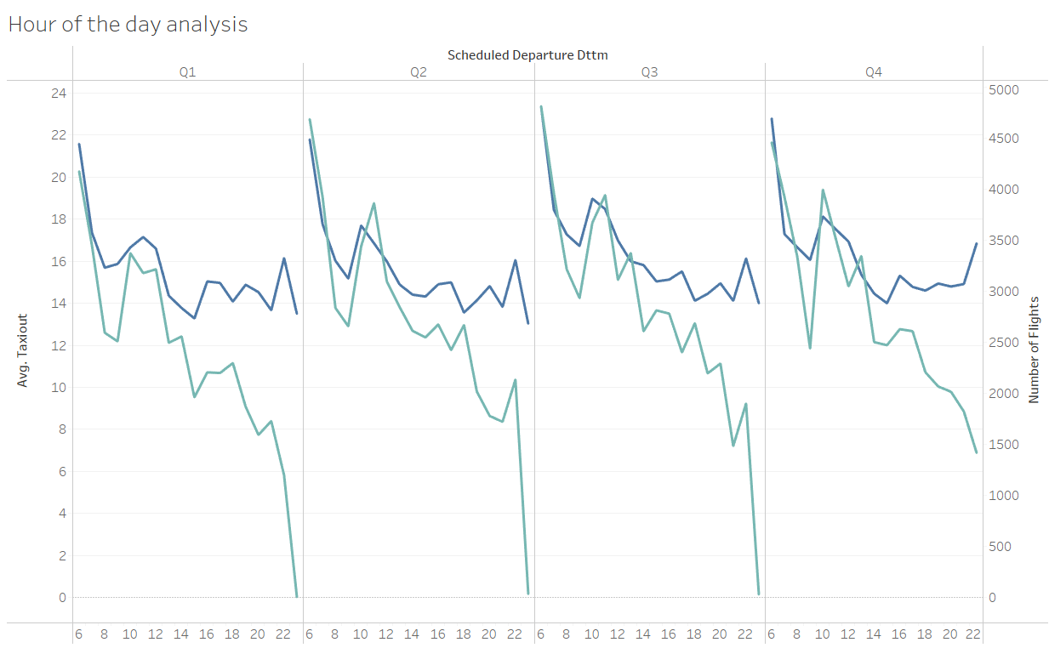
How does taxi out time vary through the day?
Influenced by hour of the day.
Also shows some correlation with number of flights departing at that time

Slide 16
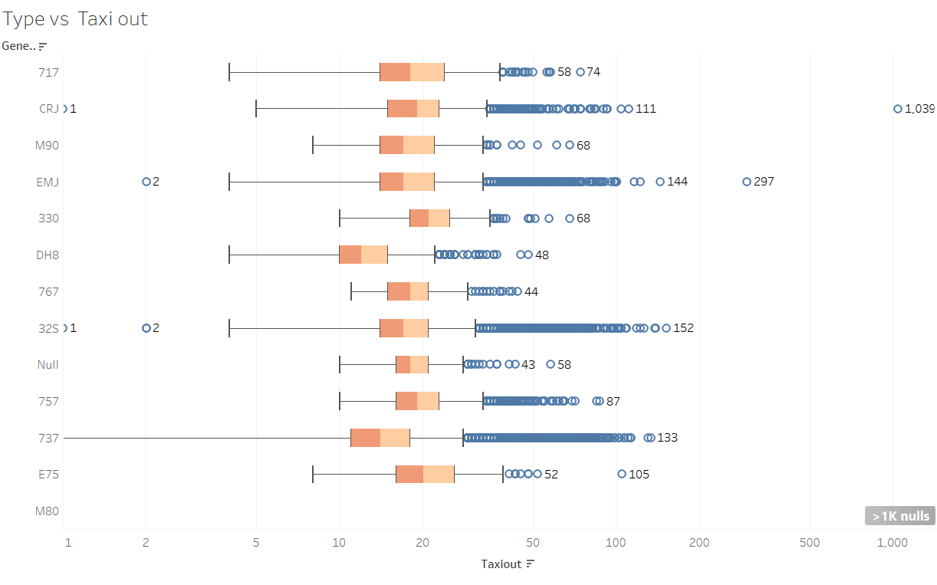
Is aircraft type significant?
Certain Aricrafts have lower Taxiout time than others:
737
32s
DH8
More than 99% of Southwest Flights are 737.

Slide 17
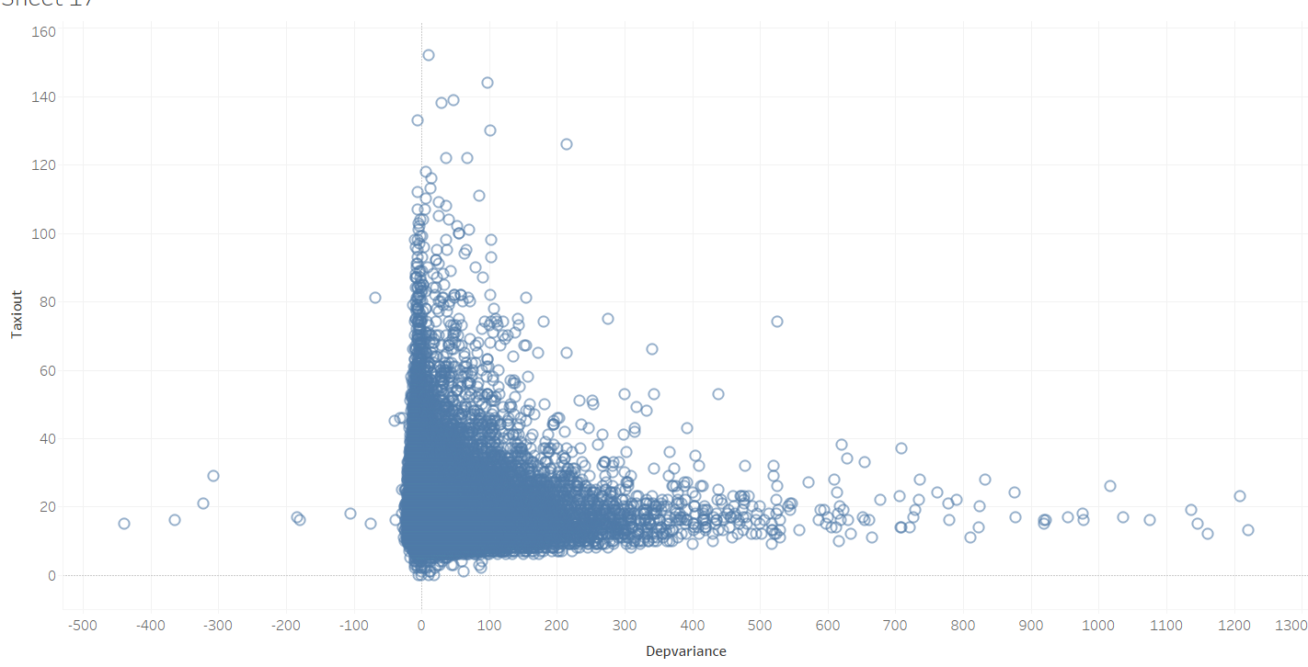
Departure Variance AND TAXIOUT
Flights which leave very early and flights which leave very late have low Taxi out times

Slide 18
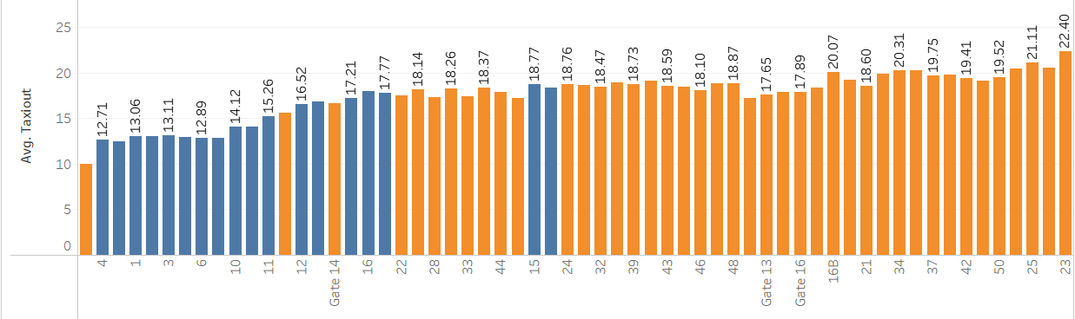
Departure gate and taxiout
In General Terminal 1(Blue) Gates have lower Taxi out than Terminal 2 (Orange) Gates.

Slide 19
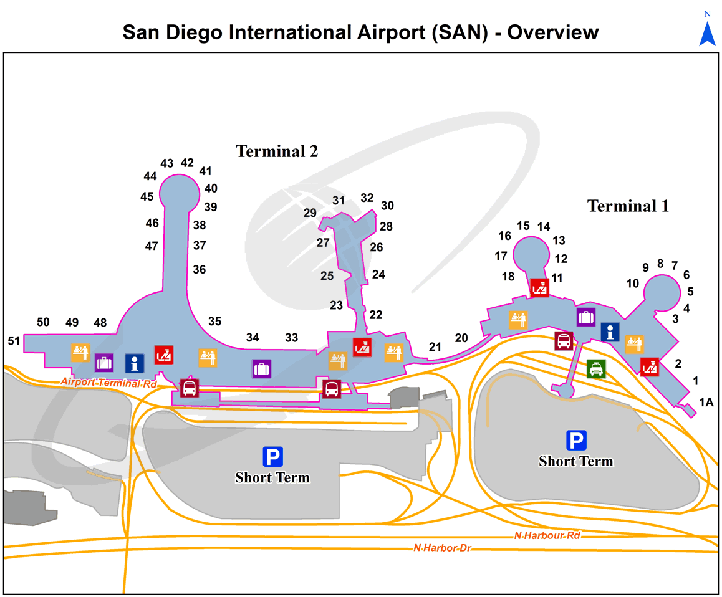
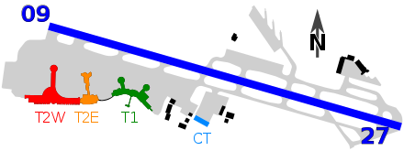
Why is Terminal Number Significant?
Terminal 1 is closer to Runway 27 which is the commonly used Runway. The shorter distance helps reduce Taxi out

Slide 20
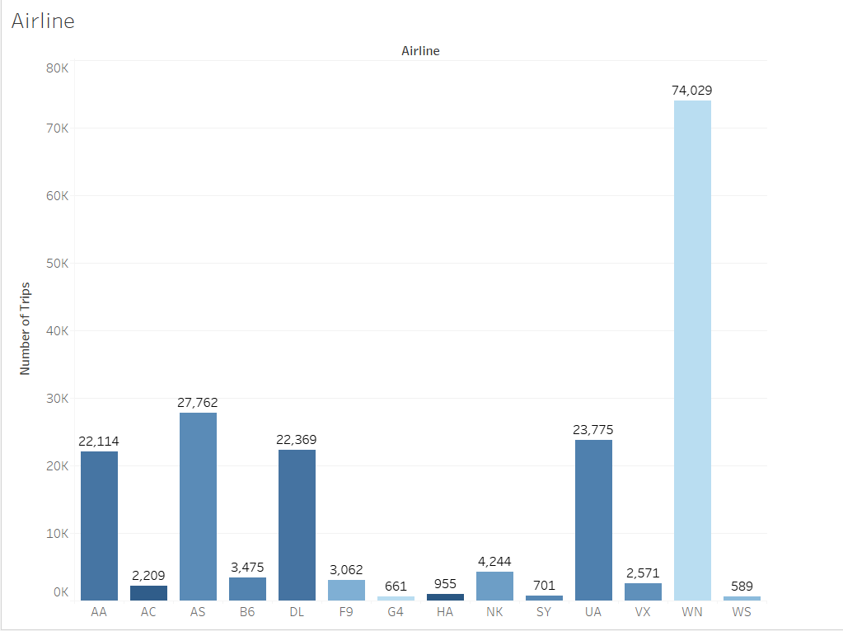
Why does southwest airline have low taxiout?
Highest Number of Flights but lowest Taxi out

Slide 21
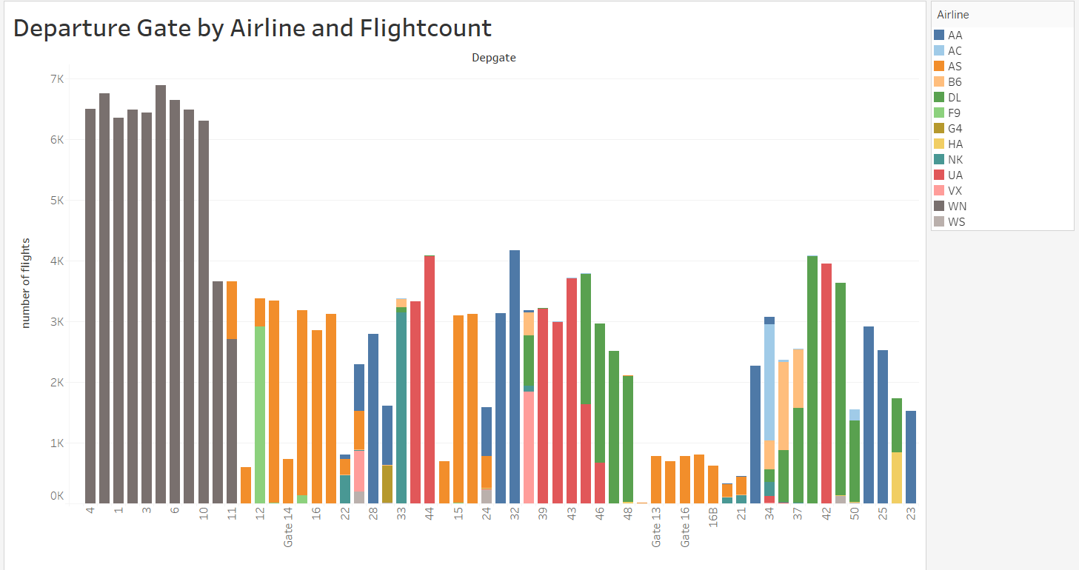
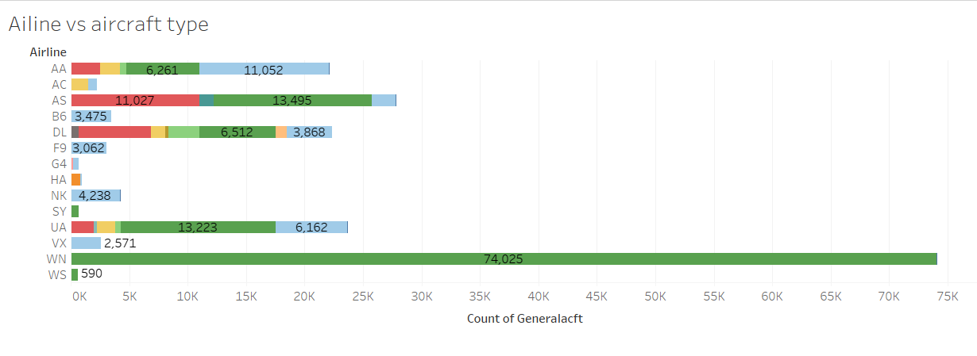
POSSIBLE REASONS
Soutwest Airlines departure gates lie within gates 1- 11 of terminal 1 which is closer to the Runway.
99% of flights are 737s which typically have low taxi outs

Slide 22
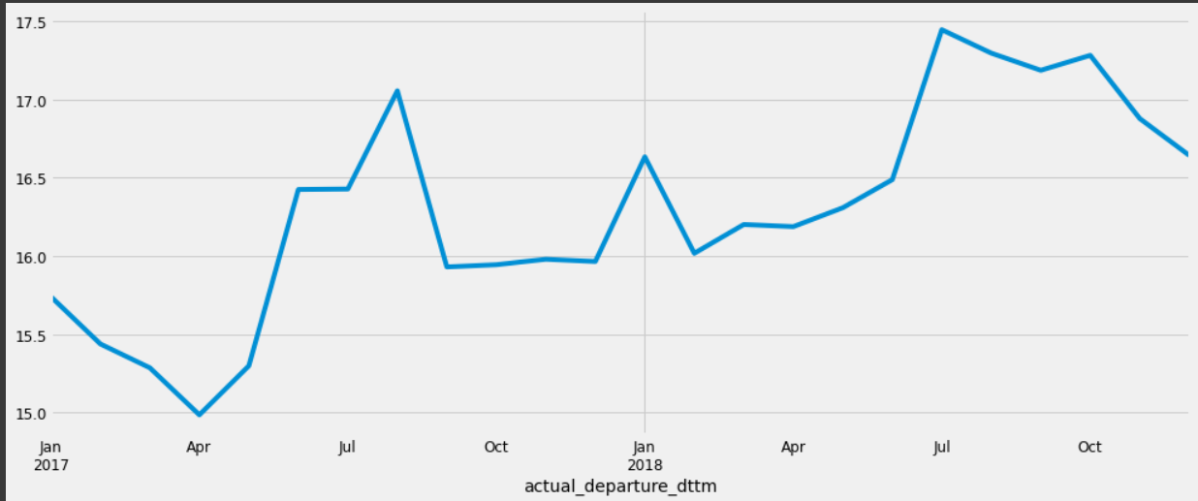
ForeCASTing Taxiout
Taxiout is time series Data since we have the value for Distinct Points in time
Aggregate Taxiout to find monthly average between 2017 and 2018

Slide 23
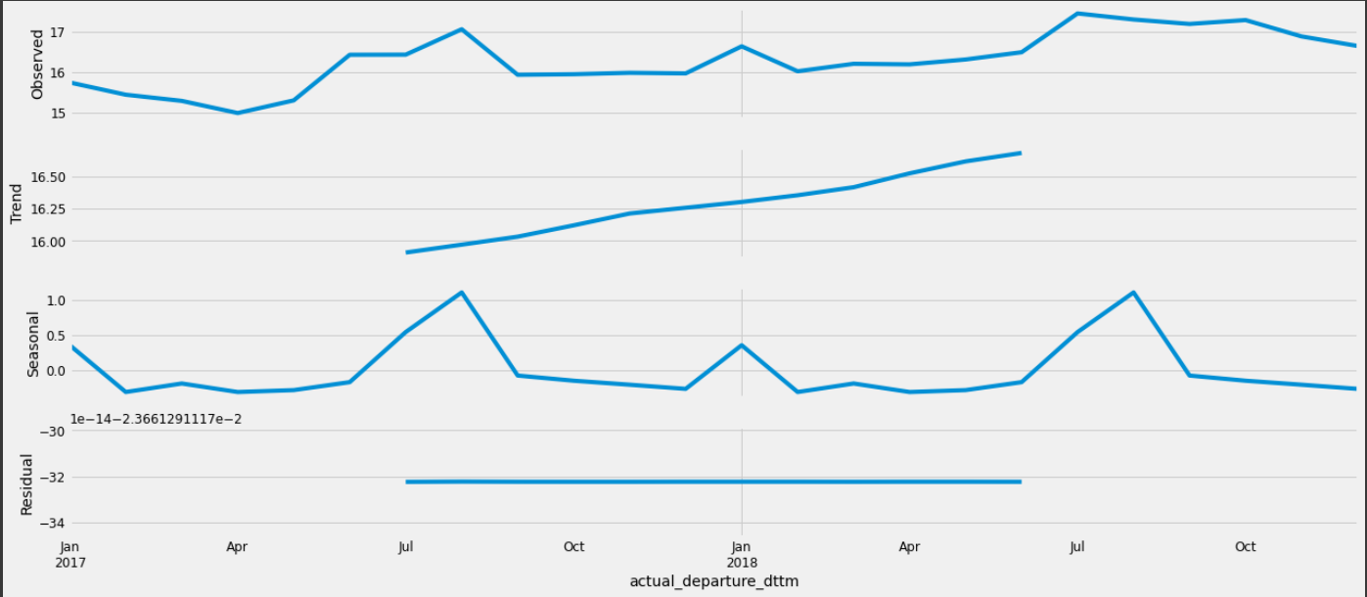
SEASONALITY AND TREND
Taxiout has an upward trend time over time
It shows minimal seasonality over a period of 12 months
The data is stationary

Slide 24
Limitations and Considerations
Method: Auto Regressive Integrated Moving Average
In particular the SARIMAX model in the STATSMODELS Library is used
The model requires the data to be stationary.
Trend and seasonality are accounted for
The autoregressive parameter p and the moving average parameter q and the lag d are chosen by looking at the Akaike Information Criterion (AIC). A lower AIC is preferred and grid search is used to find possible values of p,d and q
The optimal p,d and q values are chosen finally based on the model evaluation metric ‘Mean Squared Error’
Final Values of (p,d,q) chosen are (3,1,2) with a seasonality of 12 to represent yearly seaonality.

Slide 25
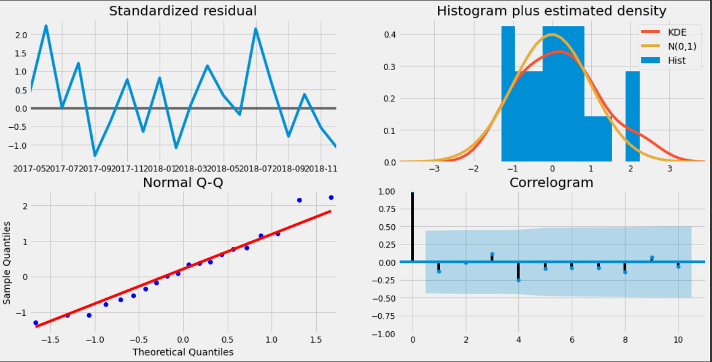
Model Diagnostics
INDICATORS OF A ROBUST MODEL
Standardized residual resembles white noise centered around 0
Smoothed Histogram of Residual closely resembles a normal curve
Points in the Normal Q-Q plot lie along the trend line
More than 95% of the correlations for lag greater than zero are insignificant (98% of values lie in the blue shaded region)

Slide 26
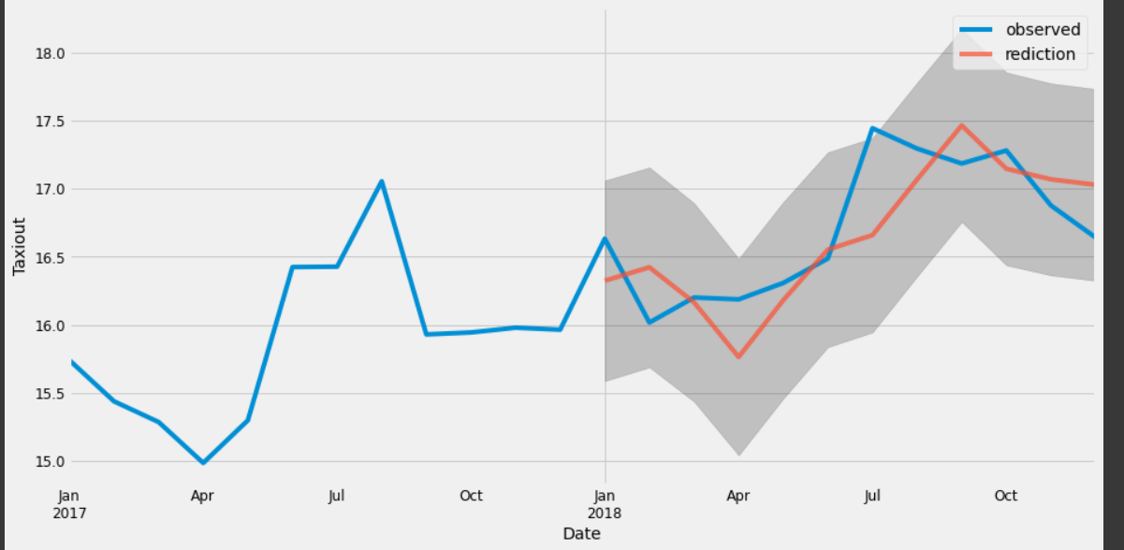
TESTING the MODEL: predicting taxiout for 2018
Taxiout values for 2018 are predicted using the model and compared with observed known values:
The Mean squared Error (MSE) is 0.12
Root Mean Squared Error (RMSE) is 0.34

Slide 27
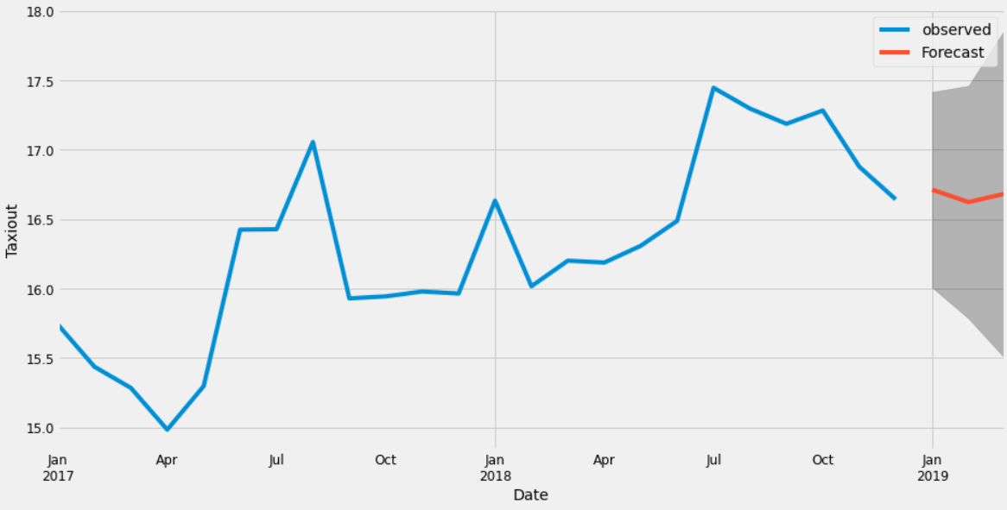
Forecasting for 2019 Jan-Mar
The model forecasts the following values of Taxiout for 2019 (JAN-MAR)
January : 16.712616 minutes
February : 16.623003 minutes
March : 16.683487 minutes

Slide 28
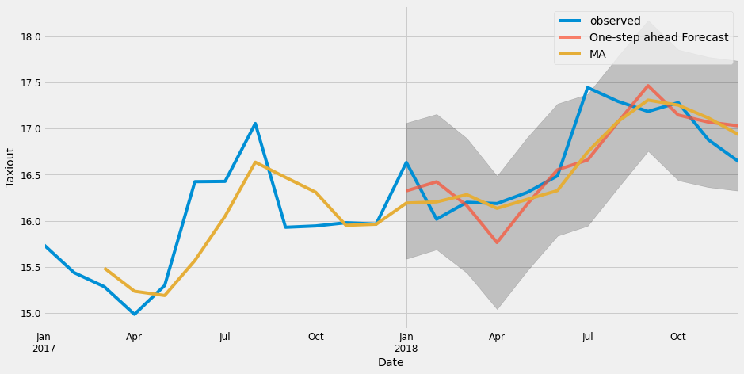
Alternative approches
Moving average calculated over recent values(past 3 months) to calculate the Taxiout value.
Comparing with ARIMA, both methods have the same MSE of 0.12 however Moving Average does not consider seasonality.

Slide 29
TAKEAWAYS

Slide 30
Most Significant Parameters for Taxiout
Time of the Day
Number of Flights
Departure Gate

Slide 31
How to improve forecast
More Data (5 to 10 years worth of Data)
Including other significant variables such as Number of Flights in SARIMAX model as an exogenous variable to increase accuracy

Slide 32
THANK YOU
Chandhnee Karthikeyan Iyer
ckiyer@uw.edu

